Slide 1
The Aging Baby Boom Generation:
Implications for Harm Reduction and Drug Policy Reform
David F. Duncan, DrPH¹
Thomas Nicholson, PhD²
John B. White, PhD²
¹ Duncan & Associates, Bowling Green, Kentucky and Alpert Medical School, Brown University, Providence, Rhode Island
² Dept. of Public Health, Western Kentucky University, Bowling Green, Kentucky

Slide 2
“Baby Boomers”
"Boomers wrestled to free America from ... overt racial bigotry, disparaging stereotypes about women, environmental degradation, and a mass conformity that led us to the Vietnam War and demeaned anyone different." (Steinhorn, The Greater Generation, p. 46)

Slide 3
“Baby Boomers”
Our fellow "baby boomers", as we all know, are noted for having engaged in more widespread illicit drug use (if we ignore the fact that alcohol was an illicit drug during Prohibition) than any other generation of Americans.
Of course, prior to the Twentieth Century the currently illicit drugs were all legal and opiates in particular were widely used.

Slide 4
“Baby Boomers”
The "baby boom" remade the American social landscape in many ways, including recreational drug use, the emergence of harm reduction, and the prospects for ending the nation's failed experiment in drug prohibition.

Slide 5
“Baby Boomers and Drugs”
The previous generation "placed so many restrictions on so many things that Boomers could never be sure which restrictions made sense and which didn't, so when they decided to experiment with something verboten and the world didn't come crashing down -- smoking pot for example -- Boomers could not but question the legitimacy of all the other moral judgments proclaimed by their elders." (Steinhorn, 2006, p. 142)

Slide 6
“Baby Boomers and Change”
As we of the "baby boom" enter our "senior years" we are changing:
The demographic profile of the nation,
the social nature of old age,
the realities of drug use and abuse among the aged, and
the politics of drug policy reform.

Slide 7
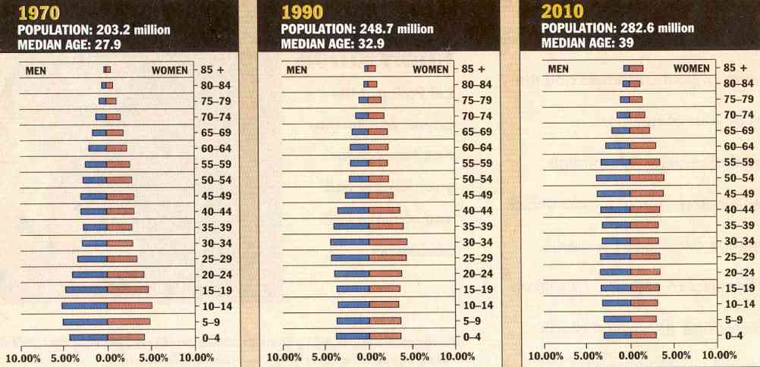
Changing Demographic Profile

Slide 8
“The Social Nature of Aging”
“Baby boomers” are changing the nature of old age:
"Just as they have transformed every age they have crossed, the baby boom generation will change the basic concepts of health in old age."
"Boomers may redefine old age and the concepts of productivity and independence by changing the basic conceptual framework."
"They may become the healthiest, most productive, and most innovative group of older people that the world has ever seen."
-- Blanchette and Valcour (1998)

Slide 9
“The Social Nature of Aging”
An AARP (2000) study found that the traditional vision of retirement is changing.
The term “retirement” to Baby Boomers means old and past it; to stay out of that reference term is still to remain young.

Slide 10
“The Social Nature of Aging”
The separation of working life from retirement was highlighted in the AARP study.
79% of Baby Boomers plan to work at least part time during their retirement.
22% will continue to work full-time, either in a new job or in a business they hope to establish after retiring.
30% will work part time mainly for the sake of interest and enjoyment;
25 % will work part time mainly for income it provides
Only 20% say they will not work at all.

Slide 11
Changing Drug Use
 | Marijuana |  | Cocaine |  | Hallucinogens
Drug Last Used | 1985 | 2006 | 1985 | 2006 | 1985 | 2006
Past Month | 0.3 | 1.6 | 0.1 | 0.3
< 1 Year | 0.4 | 1.0 |  | 0.2 |  | 0.1
> 1 Year | 4.8 | 23.5 | 1.6 | 7.8 | 0.5 | 8.4
Never used | 94.6 | 73.8 | 98.3 | 91.8 | 99.5 | 91.5
NHSDA and NSDUH 65+

Slide 12
Changing Treatment Admissions
TEDS 50+

Slide 13
Baby Boomers and Reform
" The baby boom is the first generation of free agents—the first to see and relate to the world as individuals rather than as family or community members." (Russell, 1993, p. 33)
" The children of baby boomers are destined to be much more independent than the boomers themselves. Not only do boomer parents consciously promote independence in their children, but the baby boom life-style encourages children to be independent." (Russell, 1993, p. 39)

Slide 14
Baby Boomers and Reform
“Baby boomers” are changing the politics of drug policy reform:
Surveys suggest that Baby Boomers are economically conservative but socially liberal (Boaz, 1986; Lila, 1998).
Jennings and Markus (1988) have noted that protest and confrontation declines with age.
Williamson (1998) predicts that activism by aged baby boomers is likely to be greater than by their parents but will probably be "checkbook activism".

Slide 15
Baby Boomers and Reform
“Baby boomers” are changing the politics of drug policy reform:
Public opinion polls conducted from 1969 to 2003 found public opinion in favor of legalizing marijuana use is increasing, but paradoxically it is also increasing for harsher penalties for those who possess a small amount of marijuana (Millhorn, et al., 2009).
Not surprisingly, members of the baby boom generation show the most positive attitudes toward legalization of the currently illicit drugs, much as they show more liberal views than the preceding generation on a range of social and moral issues (Milhorn, et al., 2009; Miller, 1992; Miller and Nakamura, 1997).

Slide 16
“Baby Boomers’ Legacy”
Will the “baby boom” leave behind a legacy of an America with no more
"war on drugs"?

Slide 17
Joe Klein’s Dream
"For the past several years, I've been harboring a fantasy, a last political crusade for the baby-boom generation. We, who started on the path of righteousness, marching for civil rights and against the war in Vietnam, need to find an appropriately high-minded approach to life's exit ramp. In this case, I mean the high-minded part literally."
. . .
"In any case, the drug-reform discussion comes just at the right moment. We boomers are getting older every day." Klein (2009).

Slide 18
“Baby Boomers’ Legacy”?
What will the eventual passing of our generation mean for the prospects of reform if we don't leave that legacy?

Slide 19
No “Baby Boomers’ Legacy”?
Hastings and Hoge (1986) reported a trend toward conservatism among college students with regard to attitudes concerning moral obligations and marijuana use.
Studies by Miller (1992) and Miller and Nakamura (1997) have shown shifts toward more conservative attitudes regarding marijuana use, homosexuality, and pornography for younger respondents as compared to baby boomers despite that younger generations generally liberal attitudes on other issues.

Slide 20
“Baby Boomer Futures”
Scenarios for the future:
Medicalization of Drug Abuse
  e.g. needle exchange, suboxone maintenance
Challenges in Pain Control Regimes
Legalization and Taxation of Drugs
  e.g. Proposition 19 in California
Normalization of Drug Use
Nothing Changes
  The Geriatric Prison – coping with aged illicit drug users in the criminal justice system
Harsher “War on Drugs”

